Slide 1


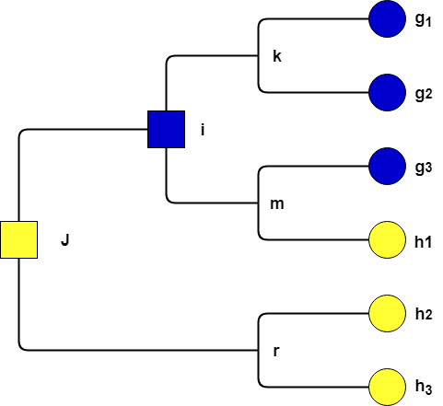

Creating a Corporate taxonomy
Marwin NIMESKERN
Grégory GUGGENBUHL
Jules CHARRON

Slide 2

Summary
What is a corporate Taxonomy ?
State of art : Taxonomy
GEA – NZ / Bugyo
Enhancement of GEA-NZ
Hierarchical Ascending Classification ( HAC )
Example Applicative

Slide 3
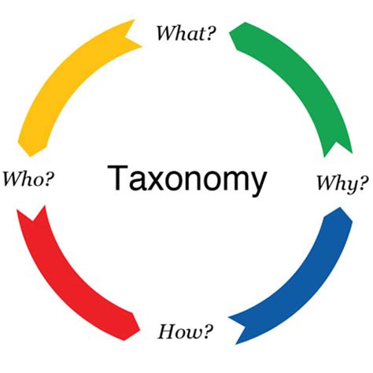
What is a Corporate taxinomy ?
Classify entities of an
Enterprise
Organization
Administration
used to classify
Documents
Digital assets
Other information

Slide 4

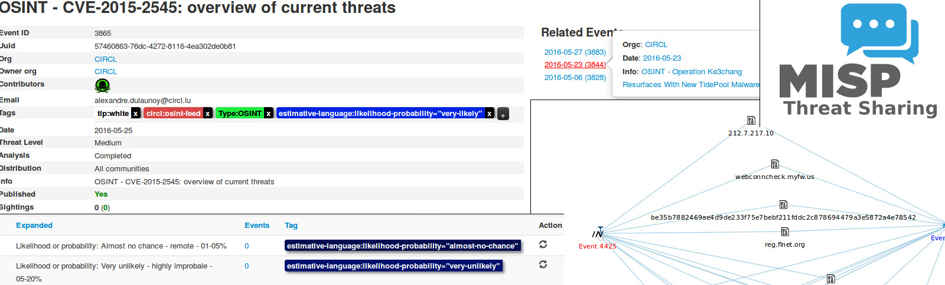

MISP: Malware Information Sharing Platform and Threat

Slide 5
ERCOT Faceted Classification
Function | Activity | Type | Entity Type | Entity | Rule Type | System Name
Market Participation | Registration and Qualification | Registration Documents | Market Participant |  | Protocol
Information Technology | System and Application Development | Revision and Change Request | Market Participant | TDSP |  | MarkeTrak

Slide 6
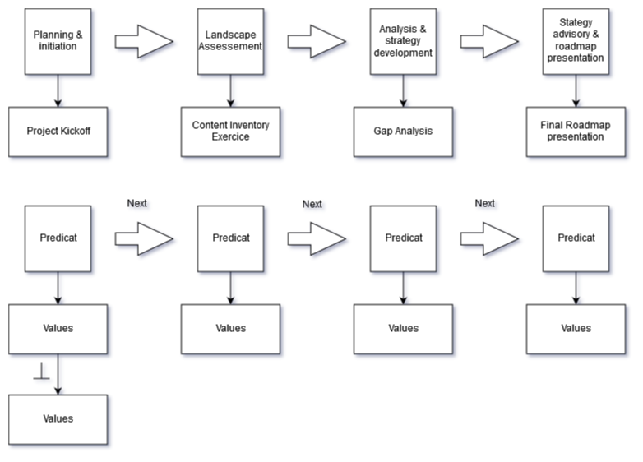
Architecting an Enterprise content management Strategy

Slide 7
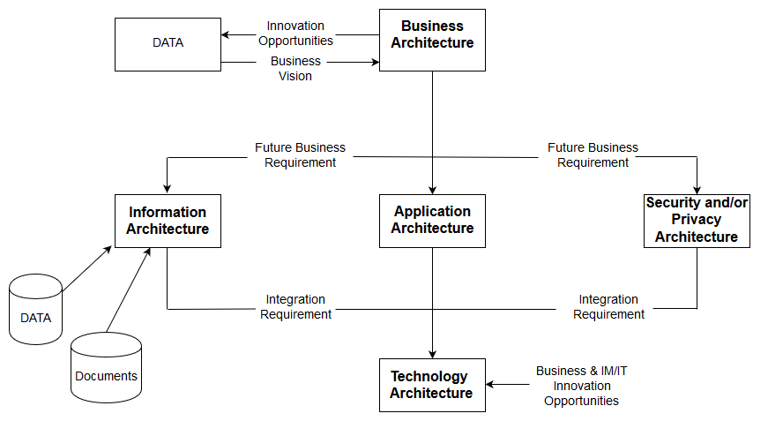
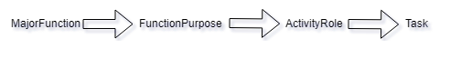
Functional Classification Taxonomies

Slide 8
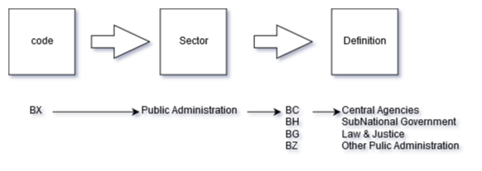
Sector Taxonomy and definitions

Slide 9
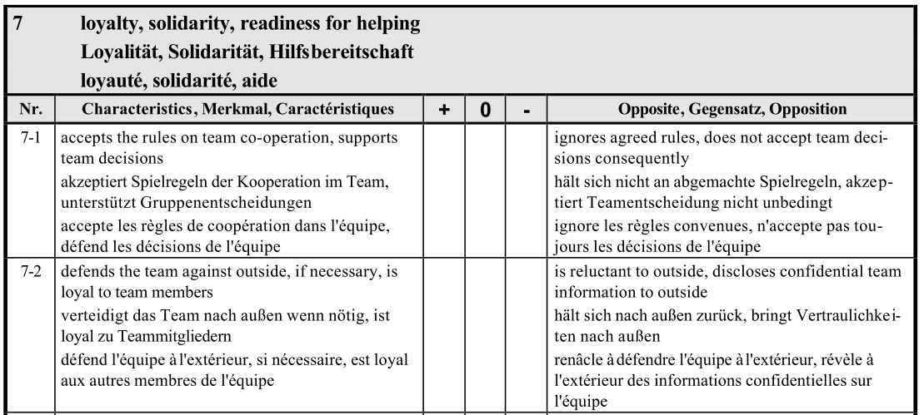
ICB Version 2: IPMA Competence Baseline

Slide 10
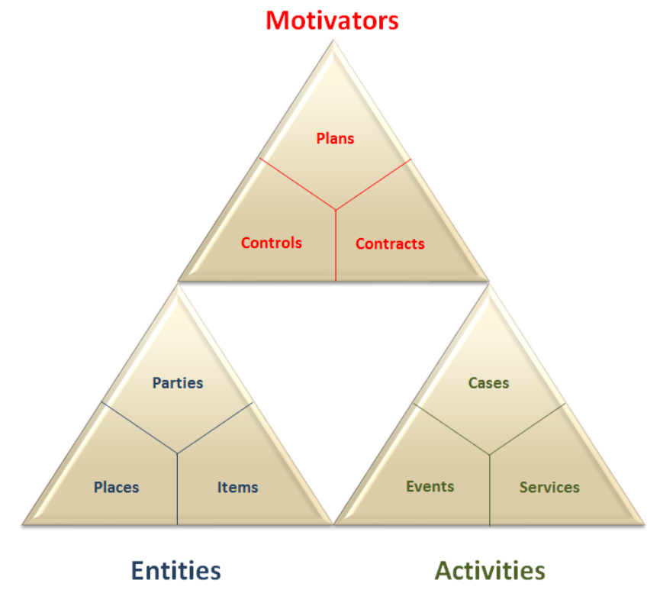
GEA – NZ

Slide 11
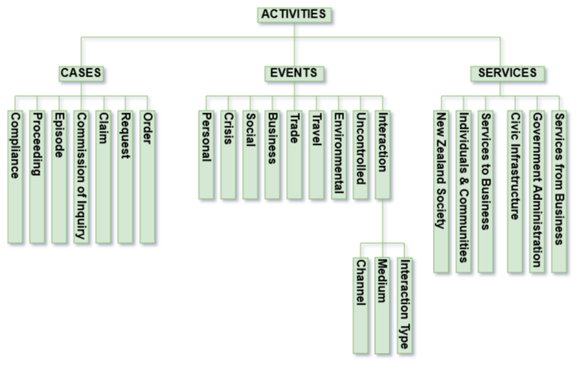

Slide 12
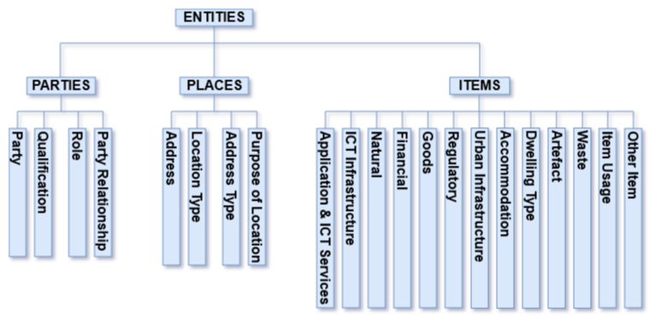

Slide 13
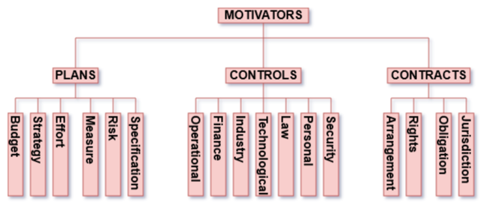

Slide 14
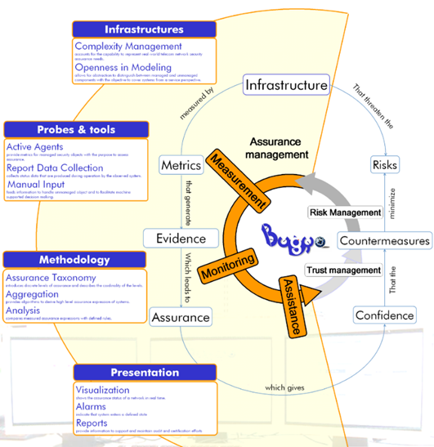
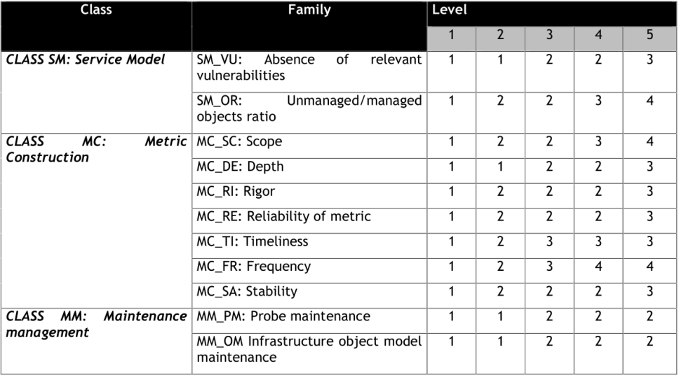
Bugyo

Slide 15
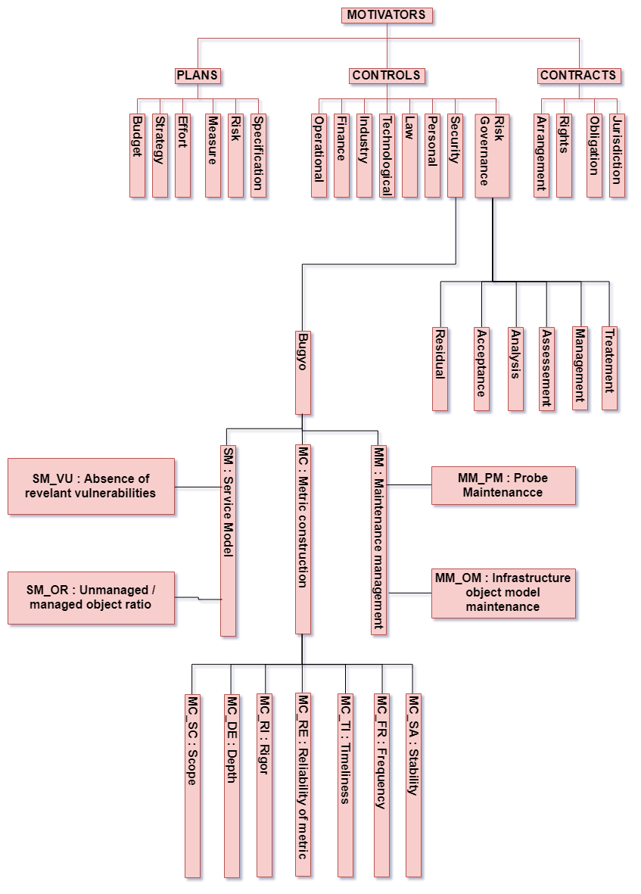

Slide 16

MISP-JSON
{ namespace": "Title of your Taxonomy",
"description": "Taxonomy to classify the information of ... .",
"refs": [
"url ... "
],
"version": 1,
"predicates": [
{
"value": "Name1 ",
"expanded": "Expanded Name 1 ",
"description": "TDesciption of the name 1"
},
{
"value": "Name2 ",
"expanded": "Expanded Name 2 ",
"description": "TDesciption of the name 2"
}
],
"values": [
{
"predicate": "Name1",
"entry": [
{
"value": " value1 ",
"expanded": "Def Value1"
},
{
"value": "value2",
"expanded": "Def Value2"
}
]
},
{
"predicate": "Name2",
"entry": [
{
"value": " value1 ",
"expanded": "Def Value1"
},
{
"value": "value2",
"expanded": "Def Value2"
}
]
}
]}
Namespace : predicate = ``value’’
Fichier Json pour Misp
taxonomy_activities
taxonomy_entities
taxonomy_motivators

Slide 17
Hierarchical Ascending Classification
WHY Classify?
To classify all the instances created
To present wiser choices to the client
To create some directory for the instances created
WHAT Classify ?
All object created thanks to the GEA-NZ and our structuring tables
HOW Classify ?
Multi-Level-Model
K-MEANS
UPGMA

Slide 18
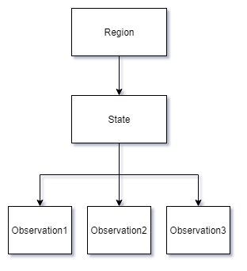
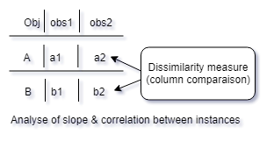
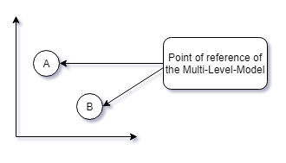

Slide 19
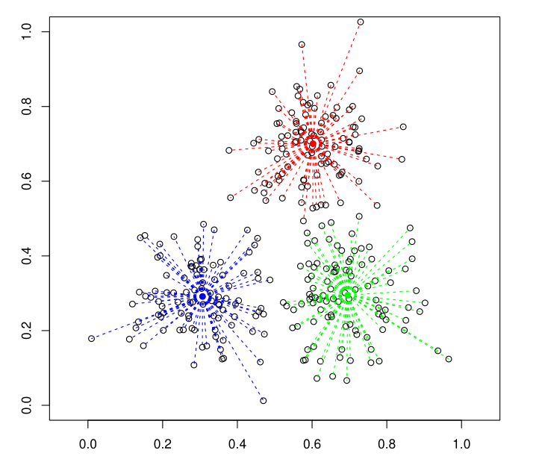
K-MEANS Determine Barycenter
Random initialization of centers
As long as the result varies
For all objects
Calculate the distance to all centers
Assign the object to the class most close
For all classes
Calculate the center of gravity of the objects assigned
Assign the center of gravity as new center of the class

Slide 20
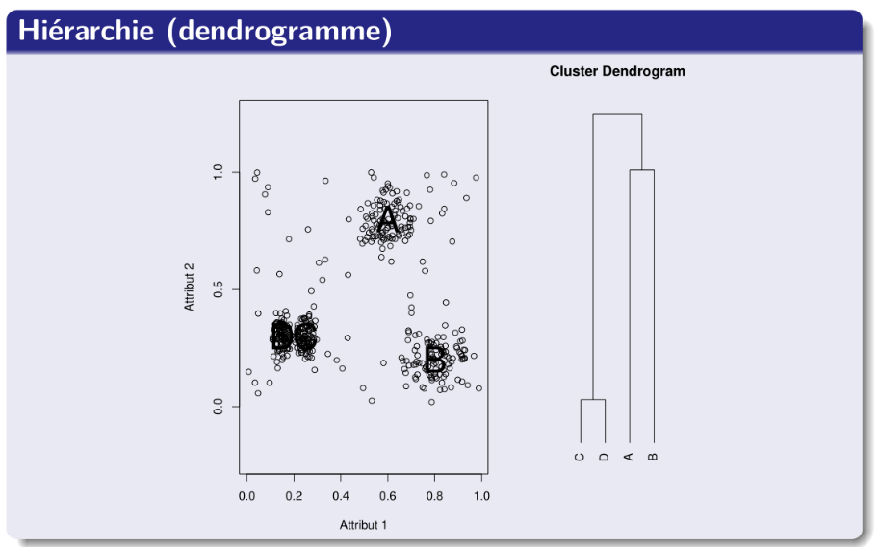
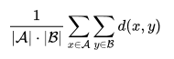
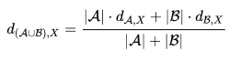
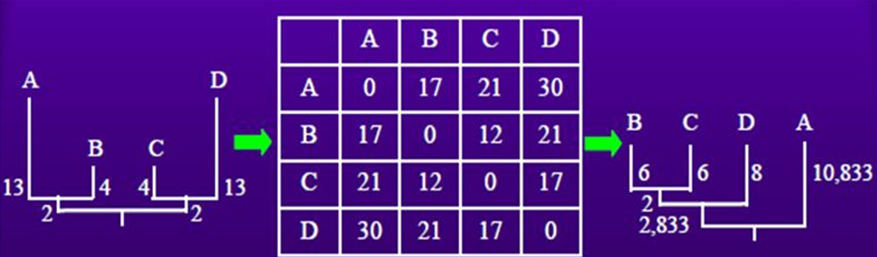
UPGMA

Slide 21


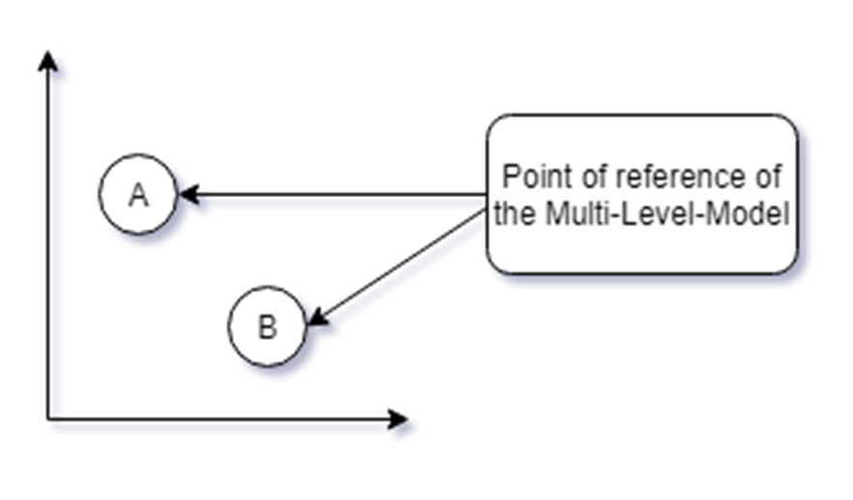

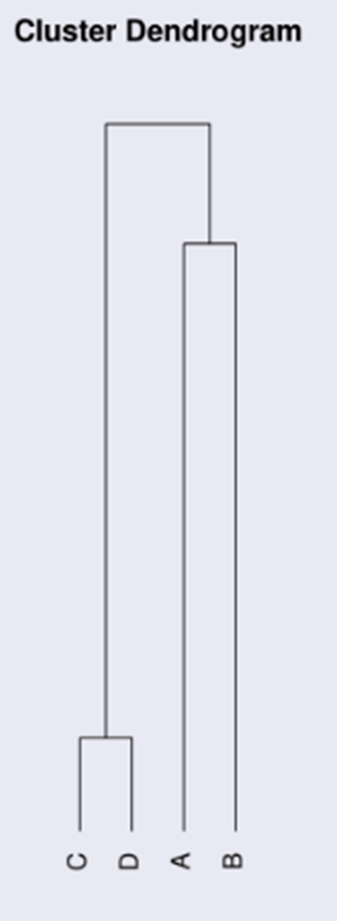
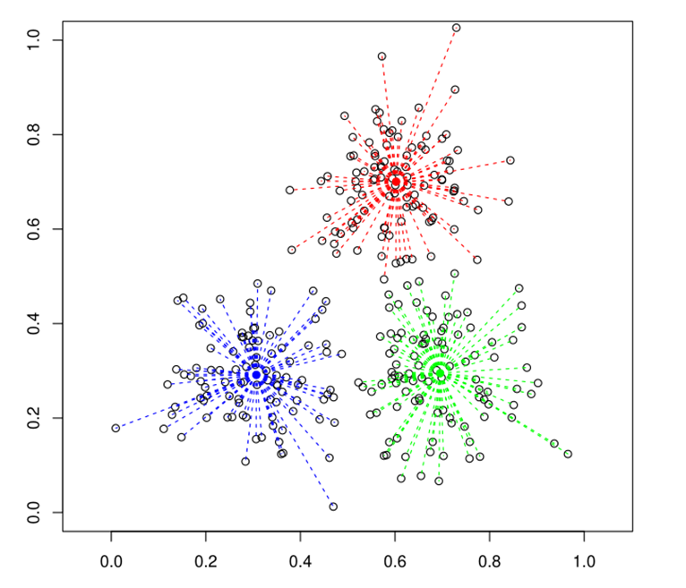
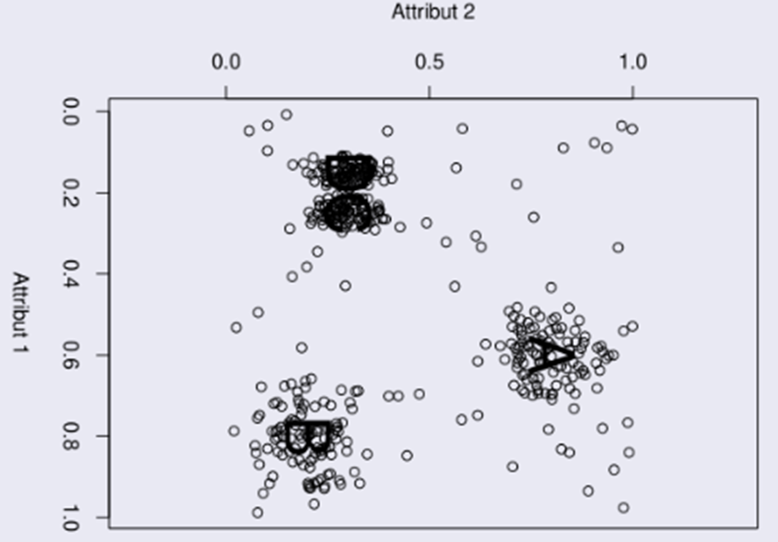

Slide 22
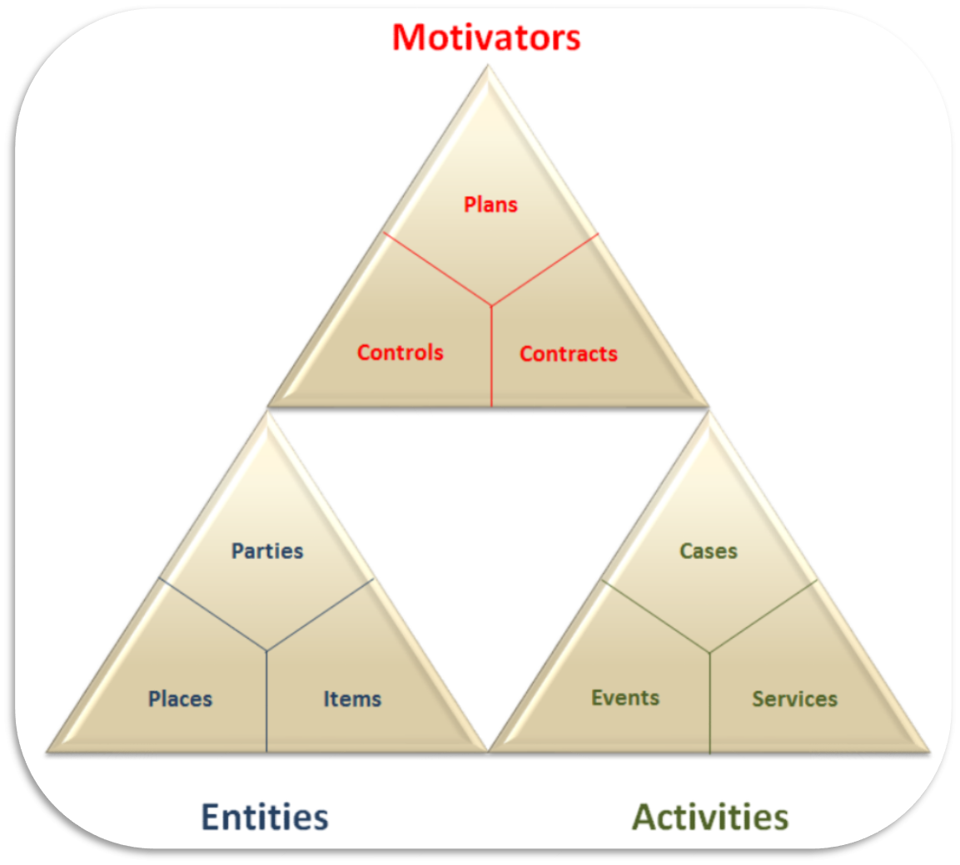
Example : Pizza Delivery Man
Motivator |  |  | Entities |  |  |  |  |  |  | Activities
Plans Strategy | Control Arrangement | Contracts Arrangement | Parties Qualification | Parties Party | Parties Role | Parties Party Relationship | Places Purpose of location | Places Address Type | Items Goods | Case | Events Trade | Services Service from business
Directive | Capability | Employement | Occupation | Individual | Commerce | Membership | Delivery | Rural Delivery Address | Food | Order | Selling | Providing Food, Drink And Accomodation
The yellow : represent the main boxes of GEA-NZ
The blue : Represent the name of the column
The white : Represent the Pizza-Delivery-Man
Example of table template for a job

Slide 23

Source – Annexe
http://slideplayer.fr/slide/1153793/3/images/68/Conclusions+sur+l%E2%80%99UPGMA.jpg

Slide 24



Thanks for watching

